Slide 1




Introduction to programming
Week 3 - 4A58
Dogan (doyi@itu.dk) Eva (evch@itu.dk)

Slide 2

Agenda
Boolean values
Boolean operators
Examples, of course
Elif?
Live coding

Slide 3
Lecture feedback?
Feedback
How do you feel about the current lecture? Any remarks?

Slide 4
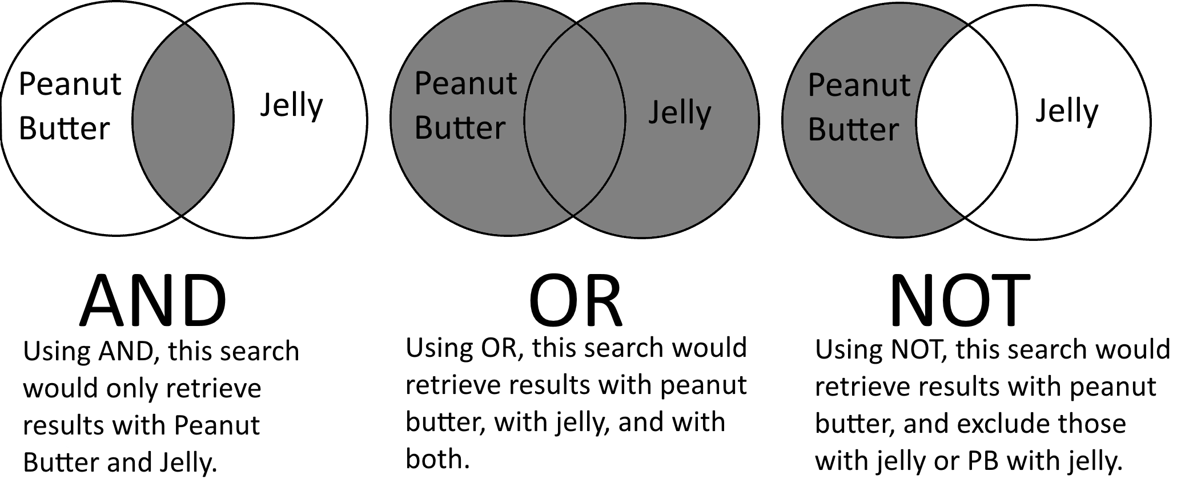
Booleans
Two values
Operators
True
False
And
Or
Not
Values are not the same as operators

Slide 5
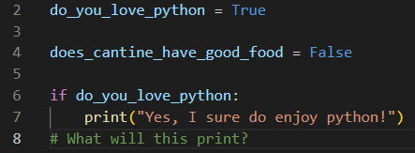
Examples! (Values)
True
False
If True:

Slide 6

Examples! (Operators)
NOT
AND
If something does NOT equal something else
Usually used as != as well in a lot of other languages, but python also uses "not".
If both statements are true.
If x is true and y is also true.
2 is not 1? True
2 is not 3? True
Both statements are true.

Slide 7

More operators
OR
Or is used when one of the two statements are true. Just one of the sides will make the whole statement true.
A car is not an airplane. (False)
An airplane is indeed an airplane (True)

Slide 8

ELIF??? Cute name, right?
(El)se (If)
If...:
Else if …:

Slide 9
Live coding? ;)

Slide 10

Thank you

